Slide 1
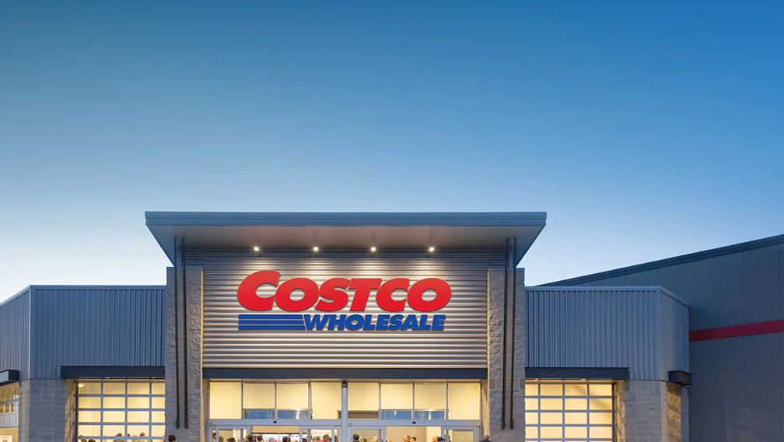
Buyer Visibility
Doug Laney

Slide 2

Douglas B. Laney
Principal, Data Analytics & Strategy @ Caserta
Douglas Laney leads the data and analytics strategy practice with the consultancy, Caserta. Formerly he was a vice president and distinguished analyst with Gartner's Chief Data Officer (CDO) research and advisory practice. He is an accomplished practitioner and recognized authority on data and analytics strategy, and is a three-time recipient of Gartner's annual Thought Leadership Award, and is regularly considered one of the top global influencers these topics. Today, Mr. Laney is also a visiting professor at the University of Illinois Gies School of Business where he teaches graduate-level courses on analytics and infonomics.

Slide 3
Contribution to Data and Analytics
Mr. Laney specializes in and assists organizations with data monetization and valuation, open and syndicated data, data governance, and big-data based innovation.
In 2001 he coined the "3Vs" of volume, velocity and variety, now commonly used in defining Big Data.
1
3
2
Nearly two decades ago, Mr. Laney originated the field of Infonomics, developing methods to quantify information's economic value and apply asset management practices to information assets.
4
Mr. Laney helped form and lead the Deloitte Analytics Institute, a global initiative to grow Deloitte's multi-billion-dollar analytics business through marketing, social media, and sales support.

Slide 4
Table of Contents
Overview
Domain - Driven Analysis
Future Work
Problems to solve
Data & Exploration
Conclusion
Project objective
Analytics Dashboard
Team
Workflow
Understanding the buyer

Slide 5

Overview
Optimizing the Depot Allocation in order to reduce the shipment costs is a very crucial task for any E-commerce company. It is because most of the companies provide their customers with free shipping facility when the total order value reaches a certain threshold. So, the shipping costs takes up a big bite in the profits of the company. Generally, the shipping cost is dependent on Distance, Weight and Dimensions of the package. It is considered that the greater the Distance, the higher the Shipment Costs and the higher the Delivery Time. To deal with all these problems’ companies tend to open multiple Depots spread all across the nation for easier, faster and cheaper deliveries. Setting up Depots at ideal locations is just one side of the problem but the real problem arises in managing the Depot.

Slide 6
Problems to solve
Which depot an item should be allocated to optimize the shipping cost?
How many units of a particular item should be allocated to a particular depot?
1
3
2
Which depot the order item should be dispatched from?
4
What is the most efficient method of shipping to drive down shipping cost?

Slide 7
Project objective
To understand customer buying patterns, forecast demand and allocate products to the right depot at the right time

Slide 8





Workflow
Logistics Flow
(Goods)
Logistics Flow
(Goods)
Logistics Flow
(Goods)
BUY
SELL
SUPPLIER
RETAIL COMPANY
CUSTOMER
Information Flow
(Requirements)
Information Flow
(Requirements)

Slide 9

Domain - Driven Analysis
Logistics Control Variables like Zip Codes, State Codes etc.
Order Details like Item ID, Item Category etc.
Customer driving attributes like Selling Price, Promotions etc.
Fulfillment Center parameters like Item Availability, Geolocation etc.
From Order to Delivery

Slide 10
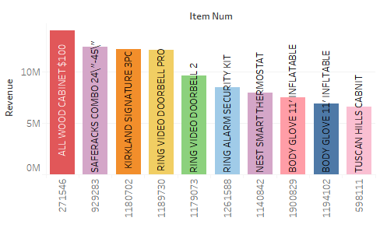
Data & Exploration
Dimensional Reduction for analysis
Pivoting for forecasting
Revenue Generating Categories and Items
Depot-wise Trends
Item Category Clusters
Department Sales Pattern

Slide 11
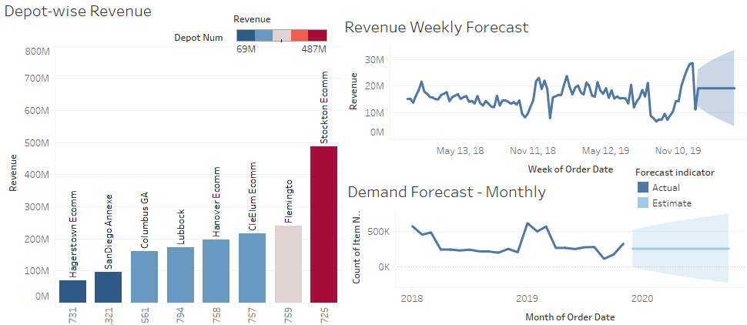
Analytics Dashboard

Slide 12
Understanding the buyer

Slide 13

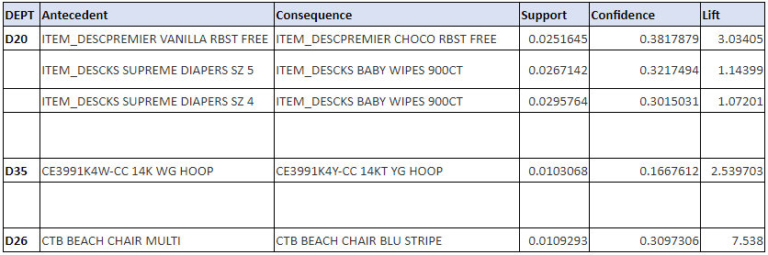
Market Basket Analysis
For discovering relationship between most purchased items against each transaction.
Strategy was to count the most frequent itemsets appearing in each transaction, converting each into matrix and finally applied Apriori Algorithm

Slide 14
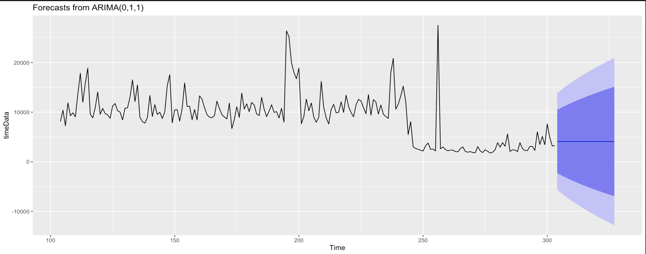
Demand Forecasting
Used Time Series Analysis for forecasting the product demand over period of next 90 days
Variable: Variables used are item number, order date and order quantity
Result: Achieved 20% Mean Absolute Percentage Error which tells % predictions differ from the true value:

Slide 15
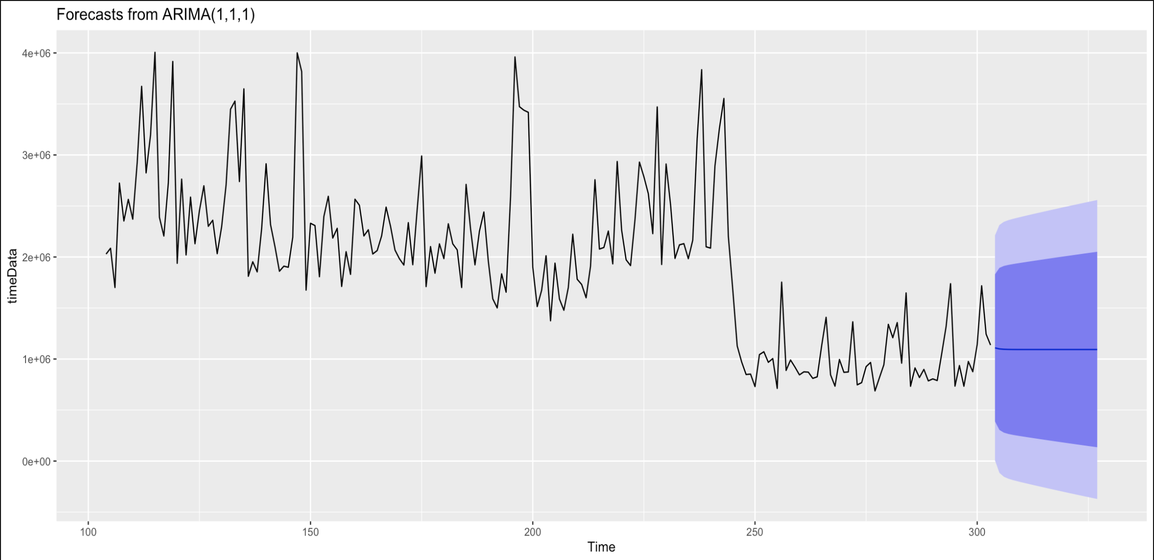
Revenue Forecasting
Used Time Series Analysis for forecasting the Revenue over period of next 90 days
Variable: Variables used are item number, order date, Selling Price, Order Qty used to derive the Revenue
Result: Achieved 15% Mean Absolute Percentage Error which tells % predictions differ from the true value:

Slide 16
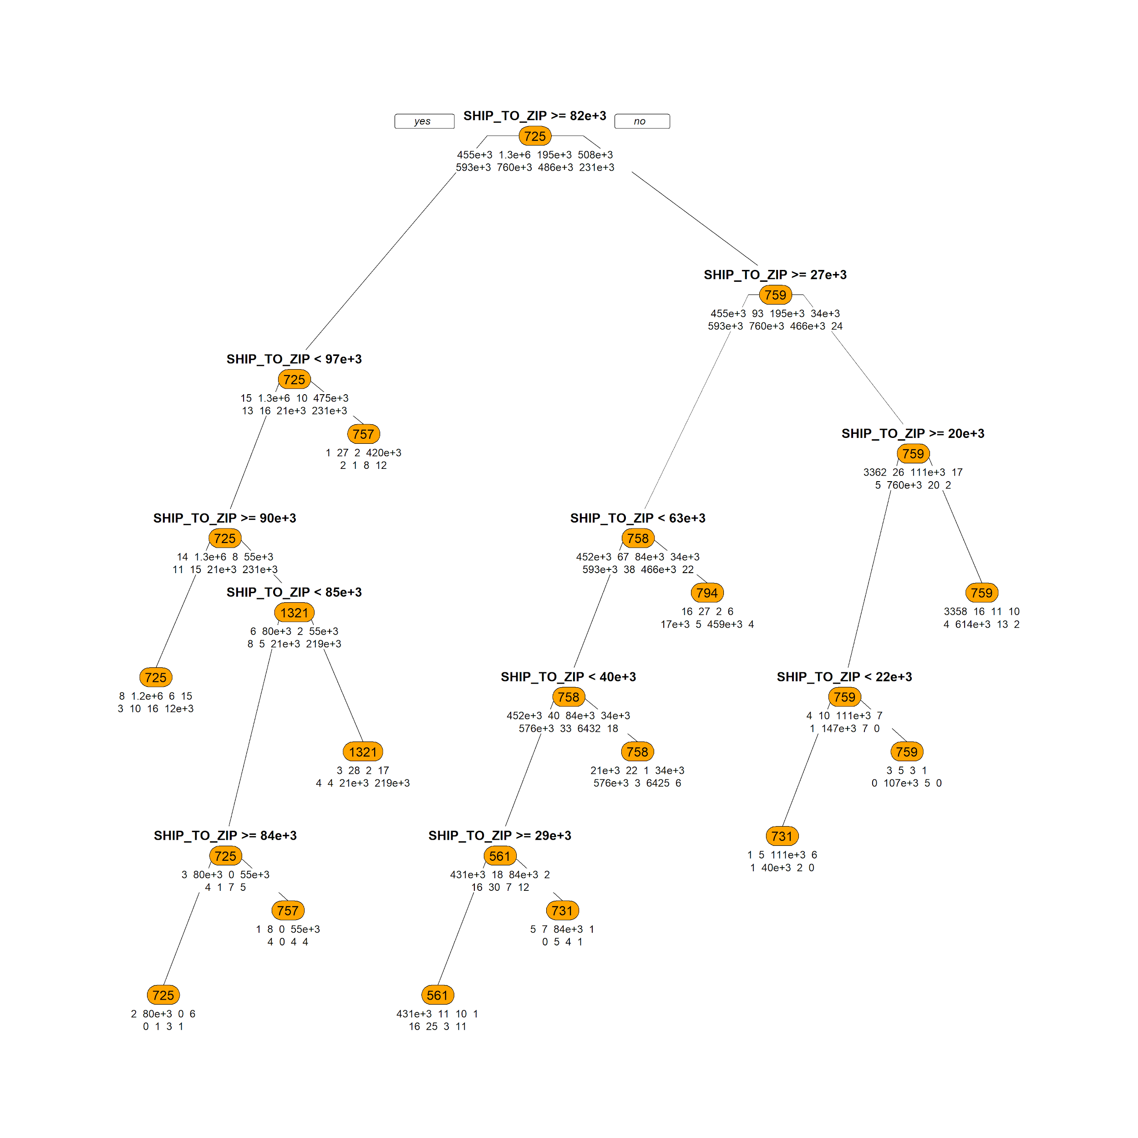
Decision Tree
To find the optimum path for delivering products from specific Depot to Specific ZIP
Variable: Depot number, Ship to ZIP & Item Number
Result:
Achieved 96% accuracy
P-Value < 2.2e-16
Performance Metrics : Accuracy, Confusion matrix, P-Value

Slide 17
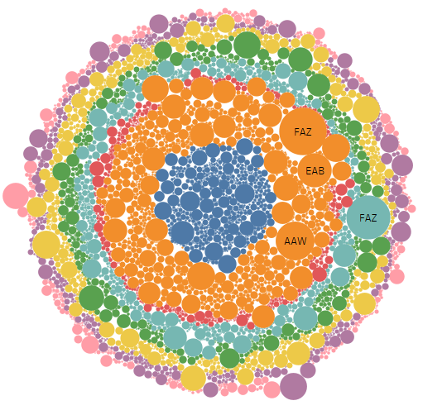
Naïve Bayes Classifier
To Classify Depot number based on State, Item numbers and Item Categories
Variable: Depot number, Ship to ZIP, Ship to State Item Category & Item Number
Result:
Achieved 97% accuracy
P-Value < 2.2e-16
Performance Metrics : Accuracy, Confusion matrix, P-Value

Slide 18
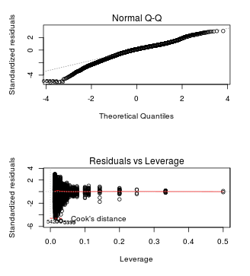
Regression Analysis
Used Multivariate Linear Regression to predict the depot on the basis of multiple coefficient/features
Variable: Depot number, Ship to ZIP, Ship to State & Item Number
Result :
R-Squared - 1
P-Value < 2.2e-16
Residual Standard Error = 3.083e-08
Performance Metrics : R-Squared, Residual Standard Error

Slide 19
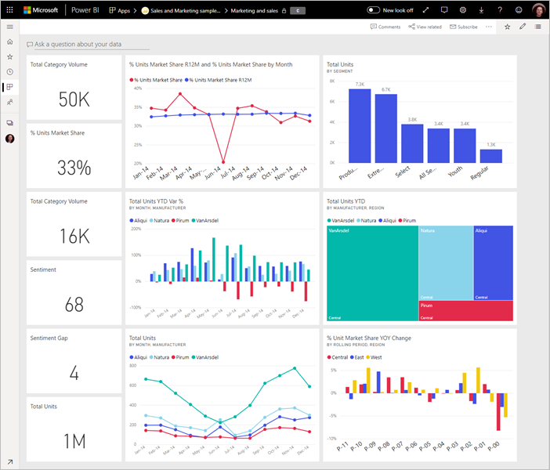
Future Work
To develop real time interactive web application in R shiny
To use Artificial Neural Network for finding the right depot based on logistic provider cost

Slide 20

Conclusion
Our Model is able to find out the strong relationship between frequent purchase products in each department.
We were able to forecast the order quantity and revenue for next 90 days.
Clustered item categories into grouped depot numbers.
Were able to predict the Dispatching Depot number based on order details.

Slide 21




Team
Machine Learning Engineer
Data Scientist
Business Intelligence Engineer
Date Engineer
Aakash Kedia
Phani Sai Kamal Lingam
Amal Sharma
Shivam Jakhanwal

Slide 22


Thank You
Prof Shrikant Palkar
Mr. Rakesh Malakar
Questions ?

